Slide 1
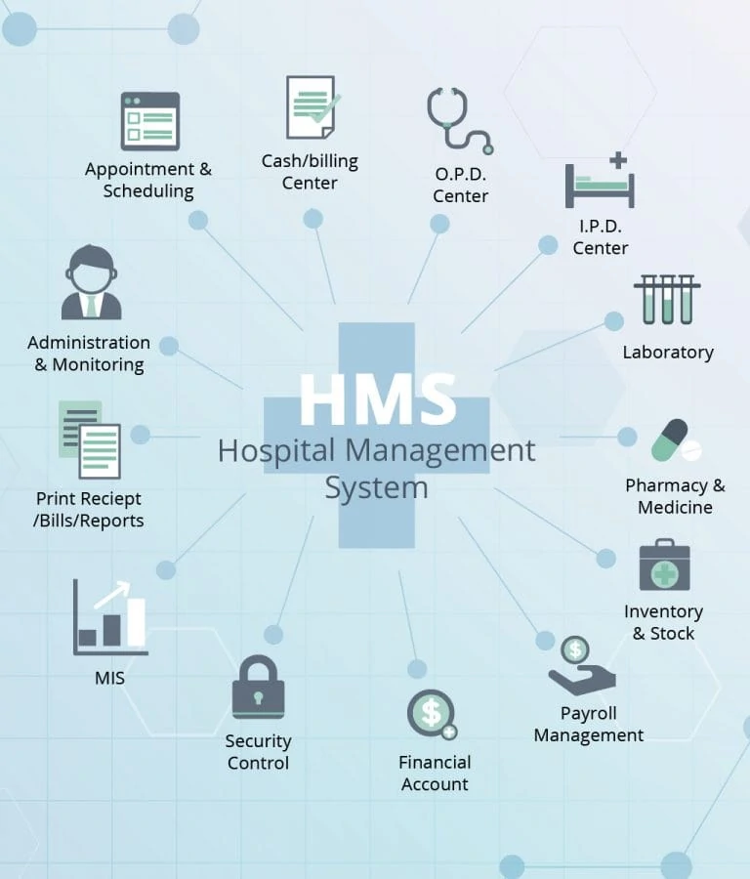
Team Mini Project
Hospital management system

Slide 2
Team members : 1)Shubham Sagar 2)Tukaram Bhalerao 3)Siddeshwar Hotge 4)Dattatray Fadtare 5)Viresh Jamma
A Very good afternoon to all present here respected sir and all my dear friends

Slide 3
Introduction
What is Hospital Management System (HMS):
Hospital management system is a computer system that helps manage the information related to health care and aids in the job completion of health care providers effectively. They manage the data related to all departments of healthcare such as,
Clinical
Financial
Laboratory
Inpatient
Outpatient
Operation theater
Materials
Nursing
Pharmaceutical
Radiology
Pathology etc.

Slide 4
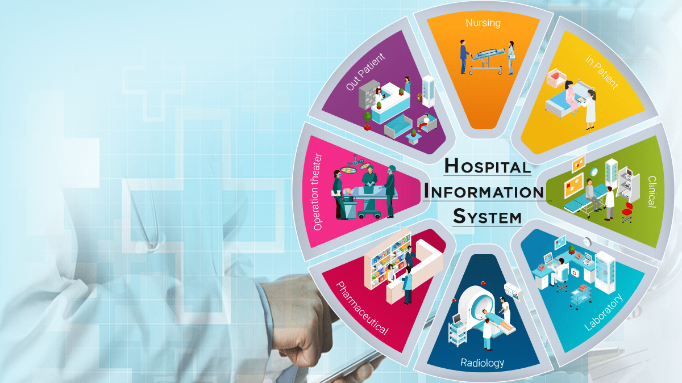
HMS came into the picture of hospital management as early as 1960 and have ever since been evolving and synchronizing with the technologies while modernizing healthcare facilities. In today’s world, the management of healthcare starts from the hands of the patients through their mobile phones and facilitates the needs of the patient

Slide 5
HMS does many works like: Maintain the medical records of the patient Maintain the contact details of the patient Keep track of the appointment dates Save the insurance information for later reference Tracking the bill payments.
Why is HMS important for a hospital?
HMS was introduced to solve the complications coming from managing all the paper works of every patient associated with the various departments of hospitalization with confidentiality. HMS provides the ability to manage all the paperwork in one place, reducing the work of staff in arranging and analyzing the paperwork of the patients.

Slide 6
an Example of Hms Workflow
Patient Registration
Insurance Plan
Doctor
Diagnosis
Treatment
Patient Monitoring
Visit To Doctor
Medical Test

Slide 7
Doctor
Edit Services
Edit Doctor Details
Admin
Edit Patient Details
Receiptionist
Make Appointment
Confirm Appointment
Patient
Consult Doctor

Slide 8
Why is HMS important for a hospital? HMS was introduced to solve the complications coming from managing all the paper works of every patient associated with the various departments of hospitalization with confidentiality. HMS provides the ability to manage all the paperwork in one place, reducing the work of staff in arranging and analyzing the paperwork of the patients. HMS does many works like: Maintain the medical records of the patient Maintain the contact details of the patient Keep track of the appointment dates Save the insurance information for later reference Tracking the bill payments. : The advantages of HMS can be pinpointed to the following :
*Time-saving Technology *Improved Efficiency by avoiding human errors *Reduces scope for Error *Data security and correct data retrieval made possible *Cost effective and easily manageable *Easy access to patient data with correct patient history *Improved patient care made possible *Easy monitoring of supplies in inventory *Reduces the work of documentation *Better Audit controls and policy compliance.

Slide 9
Appointment & Scheduling
Cash/Billing Center
O.P.D. Center
Print Receipt/Bill/Reports
I.P.D Center
HMS
Administration & Monitoring
Security Control
Financial Account
Laboratory
Payroll Management
Pharmacy & Medicine
Inventory & Stock

Slide 10
Conclusion
Hospital management system is all about the modernizing a hospital through use of technology. Computers helps in it and take over the manual system for quick and easy functioning. This hospital management system is a quite the reliable and is proven on many stages. All the basic requirements of the hospital are provided in the hospital in order to manage it perfectly and large amount of data can also be stored . It gives many facilities like searching for the detail of patient , billing facilities as well as the creation of test reports. So it;s a important system for modern days

